Slide 1

Design and Implementation of Party Social Software Based on Android System
BO WANG
Supervisor : Dr Anne Hsu
Programme : MSc FT Computer Science

Slide 2

Outline
Introduction
Background Review
Design & Implementation
Evaluation & Result
Further work & Conclusion

Slide 3
Introduction
What and why ?
Party Mania is An app that
quickly finds party information based on people's spare time.
It can also match people who have similar spare time.
You can even sell your spare time to others on this app.

Slide 4
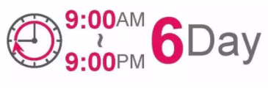
Introduction
What and why ?
Jean Twenge: “modern life is not good for mental health”. ^{[1]}
She concluded that people become unwilling to communicate and become bored and depressed.
（Working hours in China）
My app aims to let people participate in more social activities by quickly finding party information,
so as to get rid of the pressure and annoyance in life and work.

Slide 5
Background Review
Project platform - Preparation work - Contrast market apps
Aspect / Platform | Mobile | Web
Function | Camera permissions, modify files, etc. | Less permissions
Performance | Run smoothly | Load slow
Cost | Maintain iOS, Android, etc. | Only maintain HTML page
By contrast, I mix their advantages,
I finally decided to develop a hybrid application.
Client: Android development Server: data request.

Slide 6
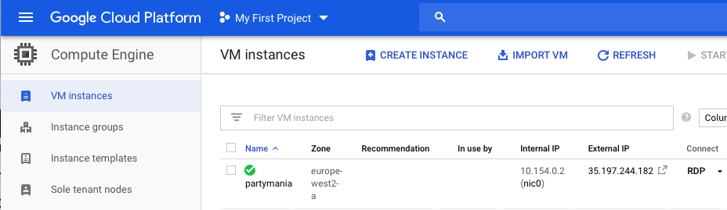




Background Review
Project platform - Preparation work - Contrast market apps
Google Cloud Server
Client coding tool
Tomcat web app Container
MySQL Database
Server coding tool

Slide 7




Background Review
Project platform - Preparation work - Contrast market apps
Similar apps
The new requirements are as follows :
The app focus on free time instead of photos.
It will not abandon any user.
It allows the release of part-time posts.
Users can browse more posts.
It has no AD, user can use all the functions without paying a membership fee.

Slide 8
Design & Implementation
Function list - Page design - Implementation work
Registration and login: basic registration and full registration.
Post new posts: share life stories, upload party posts and sell spare time.
Browse posts: view post’s content, publisher and message board, and give a post like.
Match friends: view user recommended by the application and follow a user.
Edit Profile.
Resource management: post management and follower management.

Slide 9
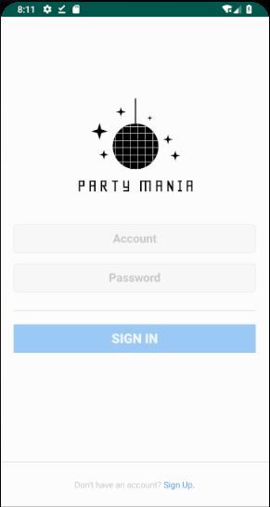
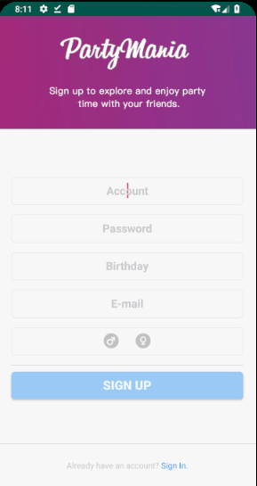
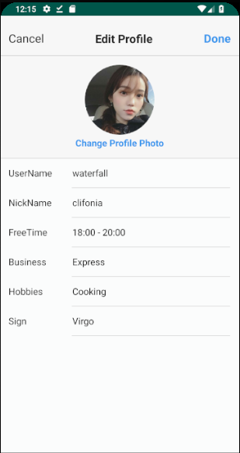
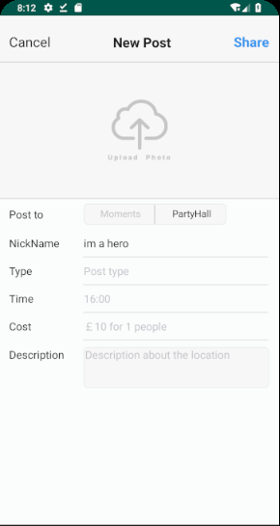
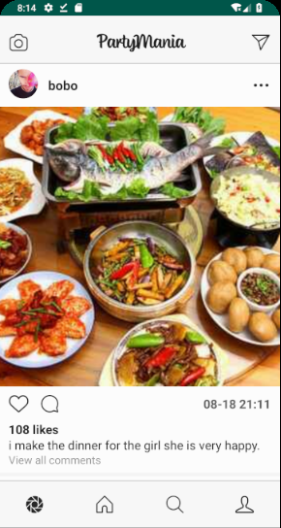
Design & Implementation
Function list - Page design - Implementation work
Login
Registration
Full registration
(Edit profile)
Post new posts
Browse posts

Slide 10
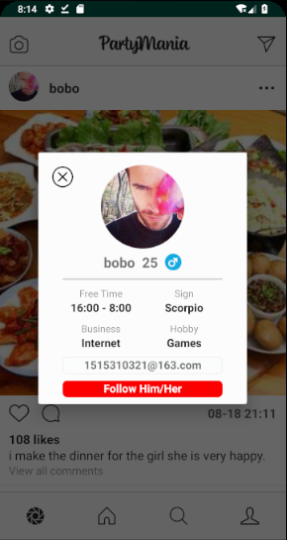
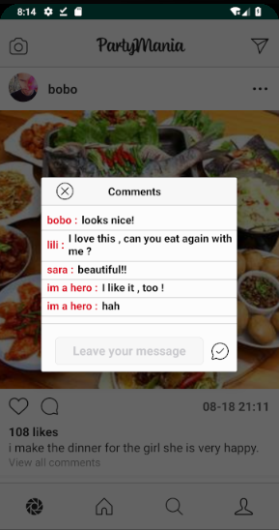
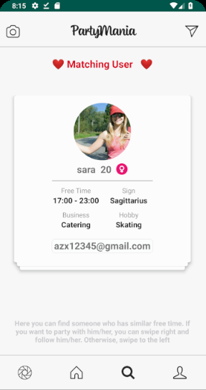
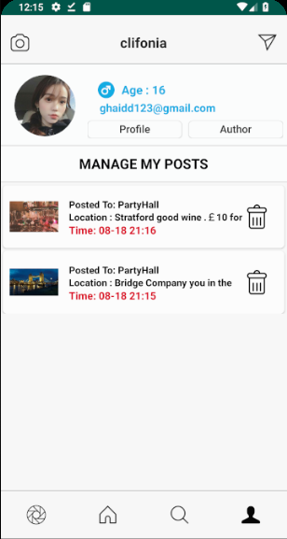
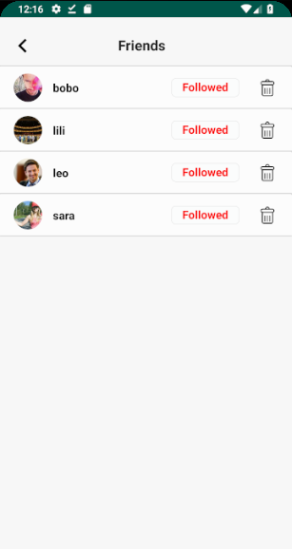
Design & Implementation
Function list - Page design - Implementation work
Publisher
Message board
Match friends
Post management
Follower management

Slide 11
Design & Implementation
Function list - Page design - Implementation work
（ Implementation process of uploading a new post ）
Android client should get system permissions (Network connection, view album).
A user selects a photo and fills in the content of the post, such as the time and location of a party.
The software compresses the photo and converts it into strings type for sending when the user clicks the share button.
The software gets the current login user id from the local cache file and packages it into a JSON object with the post content.
The software opens the thread from the background and upload the JSON object to server using HTTP protocol.
The server receives the JSON file for parsing, and add post data to the database through Servlet technology, and return a result to the client.
The client performs the result judgment processing and reports the result to the user.

Slide 12
Evaluation & Result
Evaluation method - Result processing
Cognitive walkthroughs are used to examine the usability of a product. They are designed to see whether or not a new user can easily carry out tasks within a given system.^{[2]}
Six people were divided into two groups to evaluate the app,
and each function needed to be tested with a score (out of 5 points).
Question | Group A Mark | Group B Mark | Suggestion
Will the customer realistically be trying to do this function?
Will the user notice that the correct function is available to them?
Will the user associate the correct action with the outcome they expect to achieve?
What kind of psychological changes users have during the use process?
Evaluation questionnaire

Slide 13
Evaluation & Result
Evaluation method - Result processing
The software was evaluated in two phases.
After the first evaluation, I summarized as follows:
Registration button font is too small.(4.5 points)
Registration process flashed back and did not give good feedback to the user. (4 points)
The user has to wait too long time to upload and browse posts. (2 points)
User suggestions: add post and follower management function.
My solution:
Increase the button font.
Give the thread a pause time.
Compress photos and ensure quality, change photo storage format.
Add new resources management function.

Slide 14
Further work
Optimize the running speed of the software.
Problems caused by data refresh.
Publish the app to Android Application store

Slide 15
Conclusion
Introduction: What the PartyMania . Why it was designed.
Background Review: Preparation work, such as platform, server configuration and Compare the software that exists in the market.
Design & Implement: Functions list, page design and function implementation process.
Evaluation & Result: Evaluation method, questionnaire, problem solving are given.
Further work.

Slide 16
References
[1] Lattier, D. (2016) Psychologist: “Modern Life is Not Good for Mental Health” Available at:
https://www.intellectualtakeout.org/blog/psychologist-modern-life-not-good-mental-health
(Accessed: August 21, 2019).
[2] Friis, R. (2018) How to Conduct a Cognitive Walkthrough
Available at: https://www.interaction-design.org/literature/article/how-to-conduct-a-cognitive-walkthrough
(Accessed: August 21, 2019).

Slide 17
Thank You For Listening
Showing achievement

